Slide 1
Binary Classification for Algorithmic Trading
Samuel Rector, Tommy Bi, Grace Venerus, Xiangyu Xu, Quoc Tran

Slide 2
Introduction + Motivation
S&P 500 Stock Market Index
Tracking stock prices of leading 500 publicly traded companies in the U.S.
Apple (AAPL), Boeing (BA), Walmart (WMT), Tesla (TSLA)
Factors Influencing the Stock Market
Company Performance, Investor Confidence, Economic Health, Global News Events, etc.
Investor’s Ultimate Goal: Maximizing Portfolio Returns
Actions: Buy, Hold, Sell, Shorting, Stop-Loss Order, Exercise Options
Notes:
(1 min)
stock market reflects collective investor sentiment about the future earnings and growth of public companies. The most common benchmark for investors is the S&P 500 Index, which tracks the stock prices of 500 leading U.S. companies like Apple, Microsoft, or Walmart
Stock movements are influenced by company performance, investor confidence, economic conditions, and global news. Investors often follow this index to guide decisions aimed at maximizing their portfolio returns, like buying, shorting stocks, or stop-loss order

Slide 3
Problem Statement + Task
Challenge: Accurate Stock Price Prediction
External Noises (Insider Trading, Social Media Tweets, Unsystematic Risk)
Battling the randomness associated with the stock market
Targets: Identify Stock Price Significant Movement & Direction
(1) Significant/Non-Significant Movement (Significant = >1% or < -1%)
(2) Up/Down Binary Movement
Dataset: Yahoo! Finance API, News Articles
Supporting libraries/data: Technical Analysis (TA), Pandas datareader, Key Macroeconomics Indicators (CPI, inflation rate, unemployment rate, federal funds rate), Perigon API
Notes:
Accurately predicting stock prices is difficult due to the complex interplay of factors I just mentioned and external noise like insider trading or social media sentiment or unsystematic risk - risk specifically to a company
Our research focus on two prediction targets: identify S&P 500 stock price significant movement (w/ description) and stock price binary direction
We used the Yahoo Finance API and news articles with along with other libraries and data such as technical analysis, pandas datareader, key macroeconomic data,

Slide 4
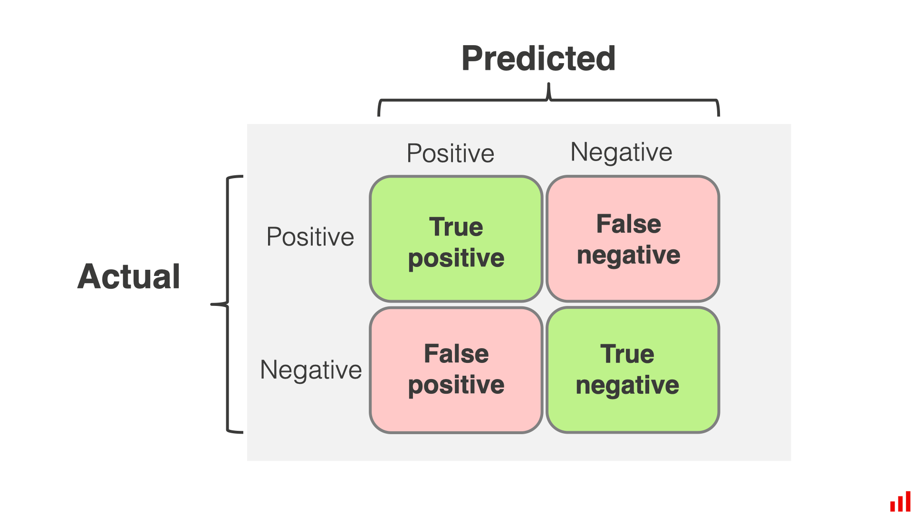
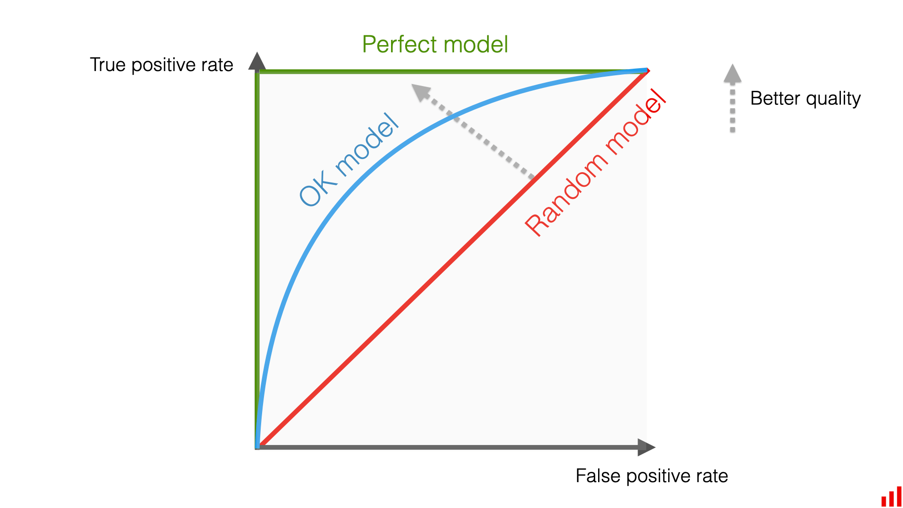
Methodology： Model + Evaluation Metrics
Naive Bayes Classifier
Train test split
Balanced Accuracies
Learning Curve
K-Fold Cross Validation
Confusion Matrix
ROC Curve
Support Vector Machine
Feedforward Neural Network
Long Short-Term Memory

Slide 5
Data Description
Open, High, Low, Close prices | S&P 500 index basic trading metrics
Technical indices | Technical indices capture stock volatility and price behavior relative to short- and long-term trends
News Articles Summary & Dates | Financial news articles from top medias for sentiment analysis
Sentiment Score | Sentiment score range from (-1,1) generated by article summaries
Macroeconomic indicators | Indicators used for measuring the effect of general economic trend on financial market

Slide 6
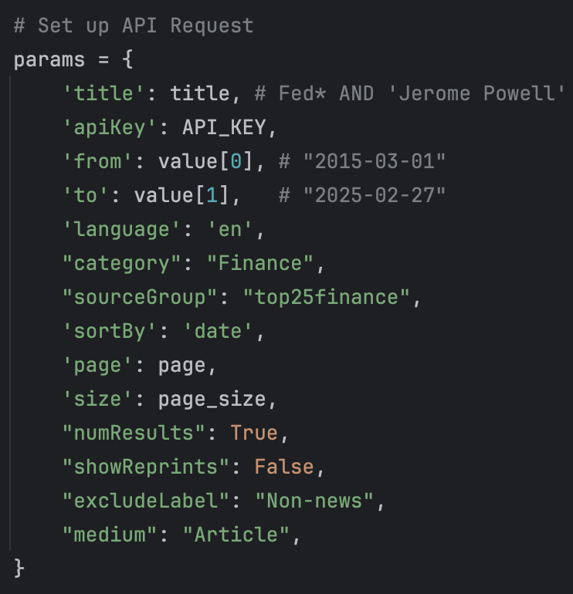
Sentiment Analysis
Rationale
Jerome Powell’s influence on the market as the Chairman of The Federal Reserve
Data Collection & Scope
Perigon API
News articles summary due to copyright restrictions
380 news articles from the top 25 financial news.
Application of Sentiment Scores
30-day exponentially weighted moving average
More weights on recent data
Notes:
Tommy
The Sentiment Intensity Analyzer in NLTK, powered by VADER (Valence Aware Dictionary and sEntiment Reasoner), operates by analyzing the sentiment of text using a lexicon-based approach. VADER contains a list of words and their associated sentiment scores (positive, negative, or neutral). When analyzing text, the analyzer breaks it down into individual words and phrases, then consults the VADER lexicon to determine the sentiment score for each word. It also considers factors like capitalization, punctuation, and negations to adjust the scores accordingly. Finally, it aggregates these scores to produce a compound sentiment score, ranging from -1 (most negative) to 1 (most positive), along with positive, negative, and neutral scores.

Slide 7
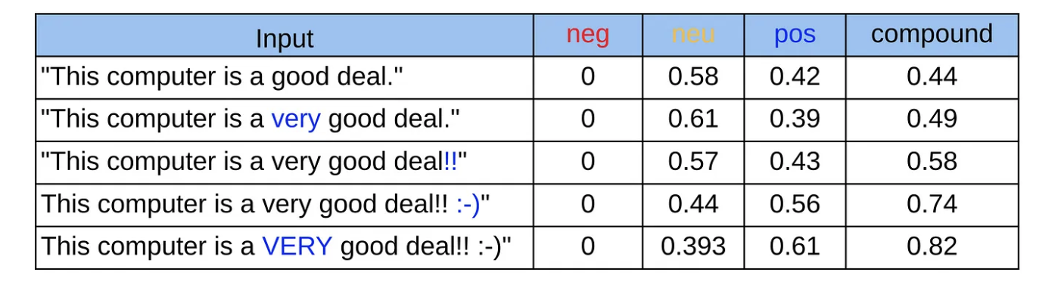
Sentiment Analysis
Nature Language Toolkit (Python::NLTK)
Sentiment Intensity Analyzer utilizes Valence Aware Dictionary and sEntiment Reasoner (VADER); Lexicon-based approach
Outputs: Sentiment based on segmentations of the text input
Percentages of Positive, Neutral, Negative features
A compound sentiment ranging [-1, 1]
Considers capitalization, punctuation, and negations
Notes:
Tommy
The Sentiment Intensity Analyzer in NLTK, powered by VADER (Valence Aware Dictionary and sEntiment Reasoner), operates by analyzing the sentiment of text using a lexicon-based approach. VADER contains a list of words and their associated sentiment scores (positive, negative, or neutral). When analyzing text, the analyzer breaks it down into individual words and phrases, then consults the VADER lexicon to determine the sentiment score for each word. It also considers factors like capitalization, punctuation, and negations to adjust the scores accordingly. Finally, it aggregates these scores to produce a compound sentiment score, ranging from -1 (most negative) to 1 (most positive), along with positive, negative, and neutral scores.

Slide 8



Evaluation Metrics
Balanced Accuracy
Handles class imbalances associated with this data - used in 8-fold CV
TPR/TNR
True Positive - correct identification of market movement
True Negative - correct identification of non-market movement
PPV/NPV
PPV - when the model predicts a significant market movement, is it correct?
NPV - when the model predicts a non-significant market movement, is it correct?

Slide 9
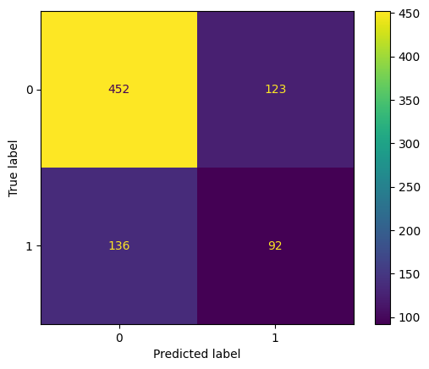
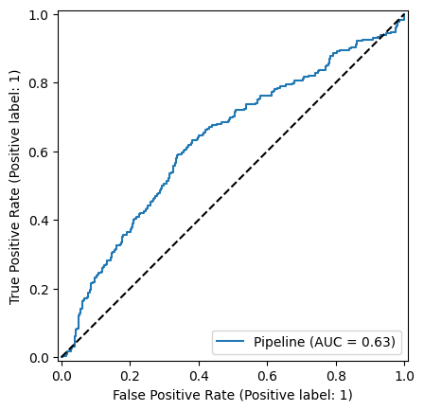
Target: Significant Movement
Naive-Bayes Classifier
CV Balanced Accuracy = 0.65
Std = 0.12
TPR = 0.4
Substantial generalization gap
1 = Significant Market Move
0 = Non-Significant Market Move
Notes:
Grace - 1 min
Diagram
https://blog.mlreview.com/understanding-lstm-and-its-diagrams-37e2f46f1714

Slide 10
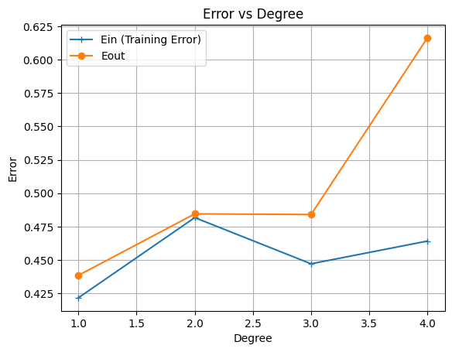
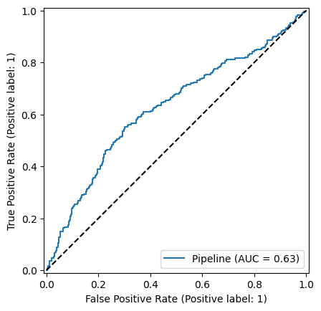
Target: Significant Movement
Support Vector Classifier (1 degree poly)
CV Balanced Accuracy = 0.57
Std = 0.09
NPV = 0.76
Small generalization gap
Notes:
Grace - 1 min
Diagram
https://blog.mlreview.com/understanding-lstm-and-its-diagrams-37e2f46f1714

Slide 11
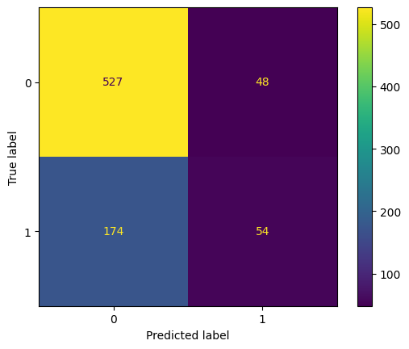
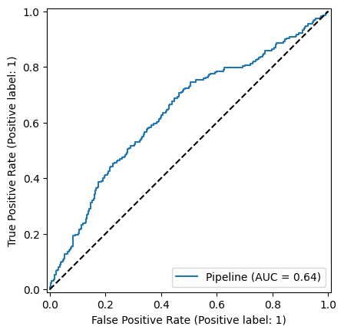
Target: Significant Movement
Neural Network (Hidden Architecture (32, 2))
CV Balanced Accuracy = 0.57
Std = 0.08
TNR = 0.92, PPV = 0.53
Smallest variance of estimates
1 = Significant Market Move
0 = Non-Significant Market Move
Notes:
Grace - 1 min
Diagram
https://blog.mlreview.com/understanding-lstm-and-its-diagrams-37e2f46f1714

Slide 12
Interpretation and Use Cases
(Type of trader -> Metric priority -> Model choice)
Options Traders -> TPR -> Naive-Bayes
Market Makers -> TNR -> Neural Network
Hedge Funds -> PPV -> Neural Network
Asset Managers -> NPV -> SVC

Slide 13
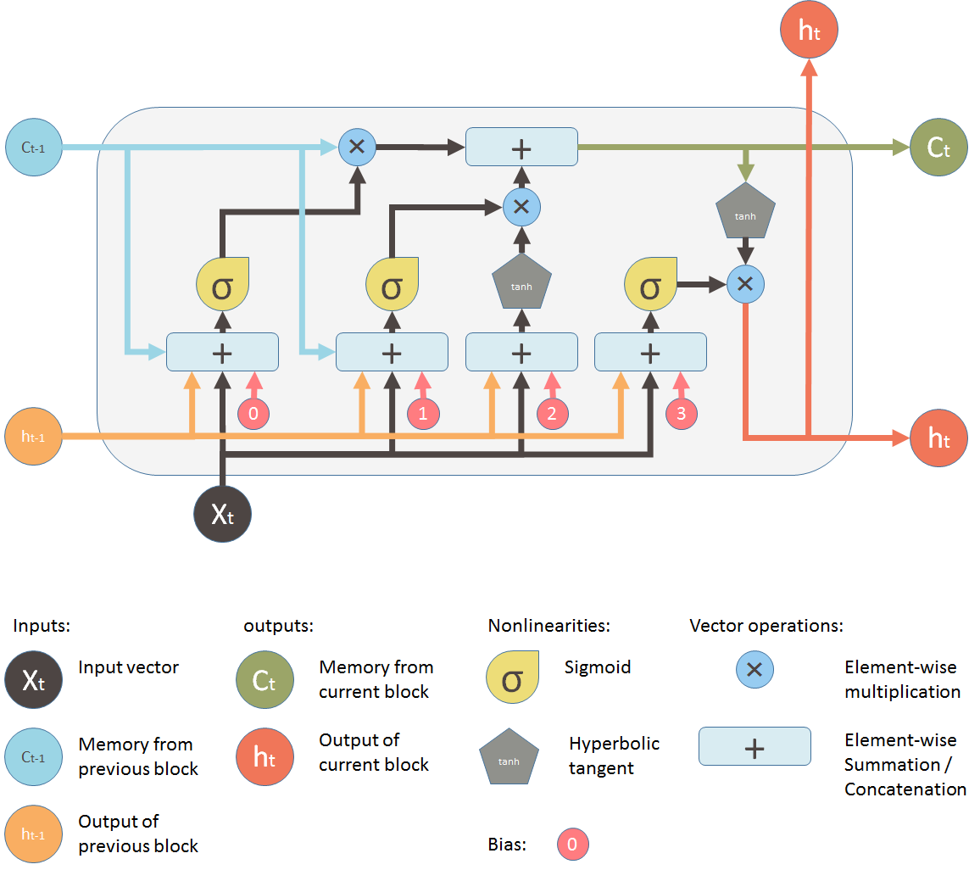
Target: Up/Down
Long Short-Term Memory (LSTM)
Special form of RNN
Specializes in long-term dependencies
Relevant for time-series financial data
Architecture
Cell state
Hidden State
Input gate, forget gate, output gate
Output functions: sigmoid, tanh
Hidden Layer Size: 64
Loss Function: Binary Cross Entropy
Ridge Penalty: L2 Norm
Optimizer: Adam Optimizer, learning rate = 0.0001
Epochs: 50
Batch Size: 32
Notes:
Grace - 1 min
Diagram
https://blog.mlreview.com/understanding-lstm-and-its-diagrams-37e2f46f1714

Slide 14
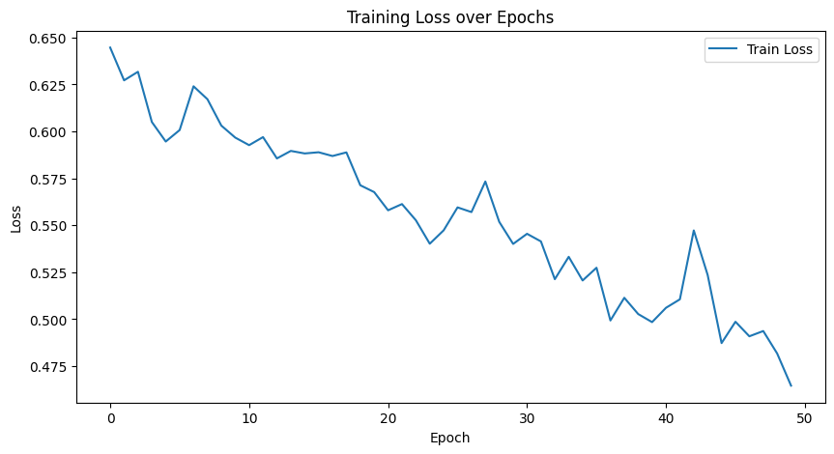
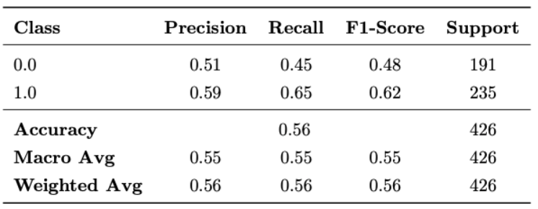
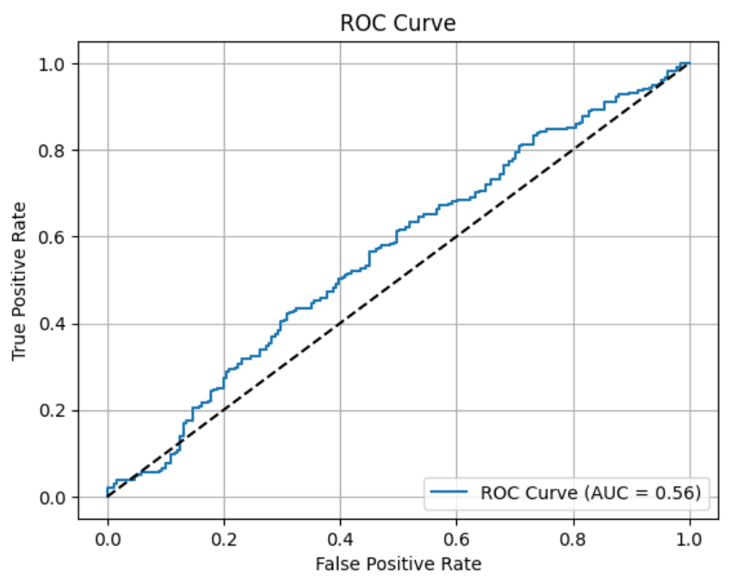
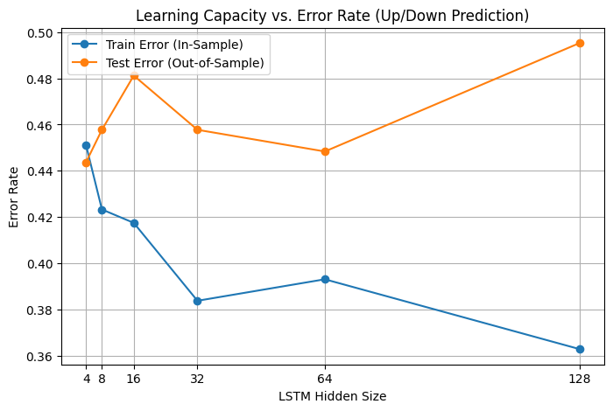
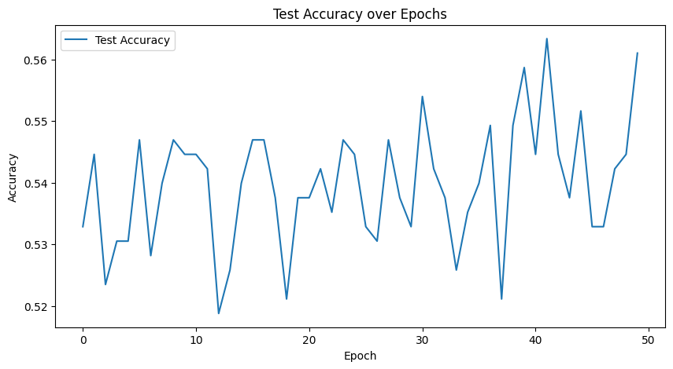
LSTM Performance + Evaluation
Balanced Accuracy
Loss + Accuracy Across Epochs
Classification Report
Train | 0.81
Test | 0.55
Learning Capacity
ROC Curve
Notes:
Grace - 1 min

Slide 15
Conclusion
Achieved: exceed the accuracy of random guessing but with substantial uncertainty
Challenge: Accurately predicting stock prices remains difficult due to many unpredictable and hidden market influences
Recommendation: prioritize model selection and tuning over feature engineering
Notes:
Uncertainty: models that predicted significant market movements achieved balanced accuracies that exceeded 50%, but cross-validation shed light on the variability of these estimates. If we only reported balanced accuracies, it would be misleading to the reader
We had focused a lot on feature engineering that included sentiment scores with technical indicators and macro data in hopes of deriving powerful insights from the data, but it seemed not to be the case. In the future, we, or anyone interested in this research, would like to prioritize model selection over feature engineering, and Temporal Convolutional Network can also be useful as the model can capture long-range dependencies in data efficiently without recurrence.

Slide 16
References
Chhajer, P., Shah, M., & Kshirsagar, A. (2022). The applications of artificial neural networks, support
vector machines, and long–short term memory for stock market prediction. Decision Analytics
Journal, 2, 100015-. https://doi.org/10.1016/j.dajour.2021.100015
Federal Reserve Bank of St. Louis. (2025). Effective Federal Funds Rate (DFF). Retrieved from
https://fred.stlouisfed.org/series/DFF
Investopedia. (2022, April 5). When Jerome Powell speaks, markets shudder. https://www.investopedia.
com/when-jerome-powell-speaks-markets-shudder-7488957
Levendovszky, J., Reguly, I., Olah, A., & Ceffer, A. (2019). Low Complexity Algorithmic Trading by
Feedforward Neural Networks. Computational Economics, 54(1), 267–279.
https://doi.org/10.1007/s10614-017-9720-6
Lynn, B. (2016). Predicting the stock market using a LSTM neural network (Master’s thesis, Lund
University). Retrieved from https://lup.lub.lu.se/luur/download?func=downloadFile&recordOId=
9137039&fileOId=9137040
Yang, J., Li, Y., Chen, X., Cao, J., & Jiang, K. (2019). Deep Learning for Stock Selection Based on High
Frequency Price-Volume Data. https://arxiv.org/pdf/1911.02502

